Slide 1
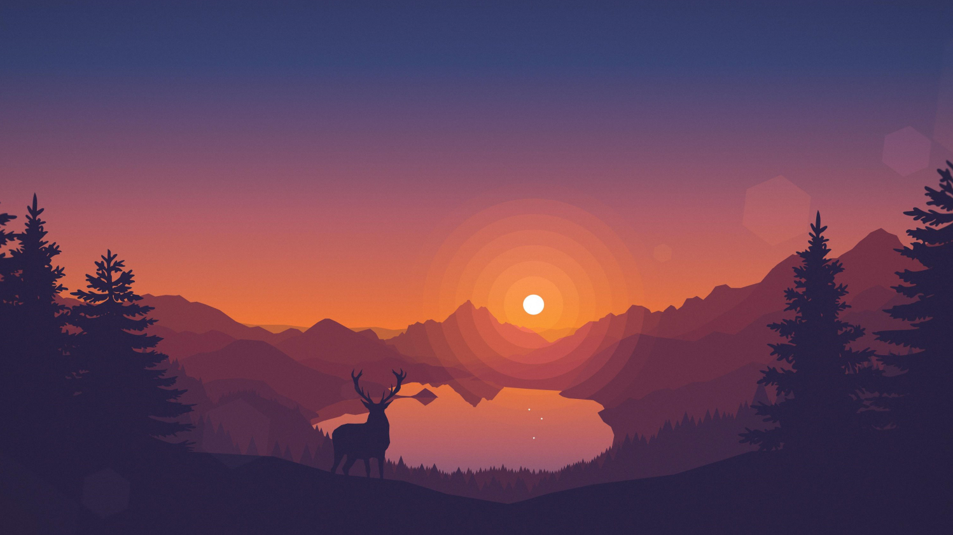
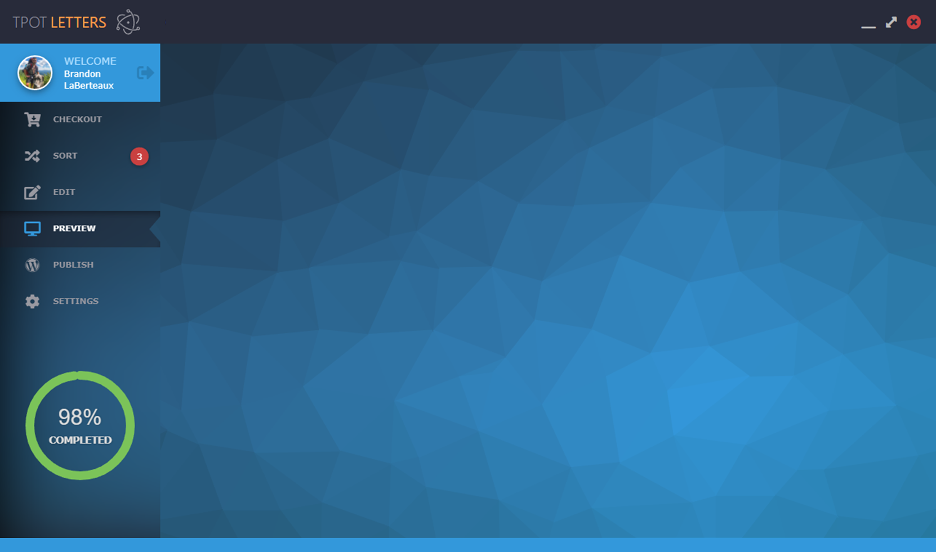
Checkout

Slide 2

Sort
Break

Slide 3
Edit

Slide 4
Preview

Slide 5
Publish

